Slide 1
How Oregon State Agencies and Universities Walk the Talk
October 10, 2011
OPHA Annual Conference
Dawn Robbins & Inge Aldersebaes, Co-Leads

Slide 2
Oregon’s Commitment to
  A statewide initiative to create healthier worksites guided by leaders from business, public health, health care, and education
  Contributes to Oregon’s Triple Aim to:
  Improve lifelong health of all Oregonians
  Lower or contain cost of care
  Increase the quality, reliability and availability of care
Notes:
2
We launched the Governor’s Wellness Initiative in 2008 with public and private partners who are committed to making the healthy choice the easy choice in Oregon.
2

Slide 3

Roadmap for Today
  Worksite Wellness:
  A Worthwhile Investment
  Partnerships for lasting change: State Agencies; Universities
  Wellness@Work resources
Notes:
Wellness@Work Quiz – as warm up

Slide 4

If Food Were Health Care
If food prices had risen at the same rates
as medical inflation since the 1930’s:
      1 dozen eggs $80.20
      1 roll toilet paper $24.20
      1 dozen oranges $107.90
      1 pound bananas $16.04
      1 pound of coffee $64.17
    Total for 5 items $292.51
Source: American Institute for Preventive Medicine 2007
Notes:
Since 2000, employment based health insurance premiums have increased by 87%. Out pacing the rate of inflation and worker’s earnings over the past 2 decades.*
*Source: Making the case for workplace wellness programs, WELCOA
The Health and Economic Implications of Worksite Wellness Programs, American Institute for Preventive Medicine Wellness White Paper, 2008

Slide 5
Medical Costs: Tip of the Iceberg
Direct Medical Costs
Medical
Pharmaceutical
Visible
Costs
Indirect Medical Costs
Missed Work
Presenteeism
Short-term Disability
Long-term Disability
Workers’ Compensation
Non-Visible
Costs
Indirect Medical Costs = 2-3 times Direct Medical Costs
Source: William B. Baun, EPD, CWP, FAWHP
University of Texas MD Anderson Cancer Center
Notes:
Research consistently shows that the costs to employers from health-related lost productivity dwarf those of health insurance.

Slide 6
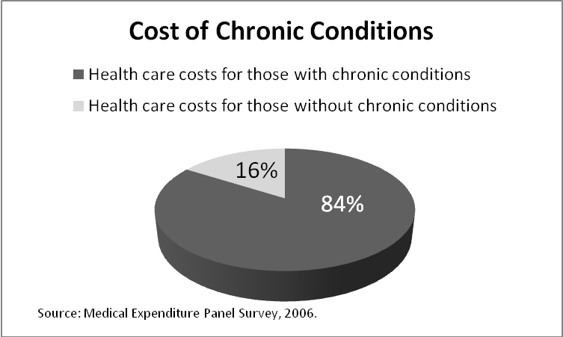


Annual Toll of Chronic Disease in Oregon
19,000 lives
$16 billion in health
care costs
Countless hours of
missed work
Notes:
If predictions hold for national health care costs, by 2015 a family of four will spend nearly $64,000 annually on healthcare.
Since 2001, wages have risen 19%, inflation has risen 17% and health care coverage has increased 78%
Almost 66% of the increase in health care spending can be attributed to increasingly unhealthy lifestyle behaviors, most prominent is obesity.
Some 28 percent of Americans have two or more chronic conditions and they are responsible for two-thirds of health care spending.
Workers’ compensation and Obesity : Obese workers, compared with average workers, file twice as many workers’ compensation claims; the cost of the average claim is five times greater; and lost workdays are 13 times higher
Over 1 in 4 people have multiple chronic disease conditions.
As a nation, we spend 85 percent of our health care dollar on people

Slide 7
Top two causes of preventable disease & death
Tobacco Use
Every year, 7,000 Oregonians die from smoking
For every tobacco-related death, another 20 people are sick
Cost: $2.4 billion in health care costs and lost productivity
Obesity
Nearly two-thirds of Oregon adults are overweight or obese
Cost: $781 million in direct medical costs
One-third of the increase in Oregon’s health care spending between 1998 and 2005 due to obesity epidemic
  Source: “Reversing the trends of obesity and diabetes: A Report to the 2009 Oregon Legislature,” Oregon State DHS
  Thorpe KE, Florence CS, Howard DH, Joski P. The rising prevalence of treated disease: effects on private health insurance
  spending. Health Affairs, W5-317-25, 27 June 2005.
  2009-2010 BRFSS Survey
  Emory University. Northwest Health Foundation Press Release: http://nwhf.org/images/files/Obesity_Report_Press_Release.pdf
  Oregon Behavioral Risk Factor Surveillance System, 2009. (Actual number 60.2 percent).
Notes:
Almost 66% of the increase in health care spending can be attributed to increasingly unhealthy lifestyle behaviors, most prominent is obesity.
Some 28 percent of Americans have two or more chronic conditions and they are responsible for two-thirds of health care spending.
Workers’ compensation and Obesity : Obese workers, compared with average workers, file twice as many workers’ compensation claims; the cost of the average claim is five times greater; and lost workdays are 13 times higher
Over 1 in 4 people have multiple chronic disease conditions.
As a nation, we spend 85 percent of our health care dollar on people with
chronic conditions.
70% of all deaths in the US can be attributed to cardiovascular disease, cancer, and diabetes. They are also the leading causes of disability and illness. The risk factors for these causes of death are tobacco use, poor eating habits, inadequate physical activity, and overweight – the good news these risk factors are preventable and modifiable!
Chronic disease accounts for 70% of all death and estimated 85% of total healthcare spending
7

Slide 8
Why Wellness at Work?
Employees spend nearly half their waking hours at work.
Environment shapes habits.
Most Oregonians want to be healthy!
Did you know that…
  80% of Oregon smokers want to quit.
  90% of overweight and obese Oregon adults want to lose or maintain weight.

Slide 9
Wellness@Work:
An Economic Imperative
A comprehensive, strategically designed investment in employees’ health pays off.
Source: Chapman LS. The Art of Health Promotion: Meta-evaluation
of worksite health promotion economic return studies: 2005 update.
Am J Health Promotion, 19 (6), July/Aug 2005
Lowers health care costs by 26%
Reduces sick leave by 27%
Reduce workers’ compensation costs by 32%
Return on Investment
For every $1 spent on wellness programs, an average of $5 (range of $2-19) is saved.

Slide 10
A comprehensive, integrated worksite wellness program
Personal Responsibility
Health Benefit Design
Supportive Environment
Culture of Health
Source: NGA Center of Best Practices

Slide 11

Can employers make it easier for employees?
To Be Tobacco Free
Eat Well
Move More
Take Charge of
their Health
YES!

Slide 12
State Agencies Walk the Talk
Biennial Survey since 2005 to assess employee risks and behaviors
Tobacco-Free Environment in largest state agency
Benefits support employees to quit tobacco and lose or maintain weight; dependents to be added
StayWell Coordinators in most state agencies
Health Improvement Plan to increase tobacco-free environments and increase healthful food and beverage options in state agencies
Notes:
PEBB (and now OEBB) provides some of the most robust tobacco cessation benefits in the country. These benefits, combined with tobacco free policies, have produced results:
•Only one in 20 OEBB (5%) members smokes, and one in 11 PEBB (9%) members, compared with one in 7 (14%) among Oregon’s overall employed and insured population.
• Nearly three in 10 PEBB and OEBB members are obese, compared with 1 in 4 among the general employed, insured population.
• Only one in four PEBB and OEBB members consistently eats enough servings of fruits and vegetables.
• Only three in five PEBB and OEBB members consistently gets enough physical activity.
• Over 90% of PEBB and OEBB members are trying to lose or maintain weight. Identifying opportunities to expand wellness and
weight management benefits and incorporate appropriate incentives for these will provide continued resources for this large

Slide 13
Healthy Life Initiative –
Planning for Healthier Communities
Partnership launched this year

Slide 14



PacificSource Healthy Life Background
Expected outcomes:
  Increased engagement
  Improved health outcomes
  Key learnings and community engagement/health improvement models
Five-year funding for wellness initiatives on both university campuses to meet health improvement goals.
Fun, social, interactive data-driven Healthy Life Challenges that ENGAGE people to improve health by developing new positive health habits.
Healthy Life Civil War Series Campus to Campus Challenge kicks off next month.

Slide 15
University of Oregon Healthy Campus Initiative
Envisioned Future: A Culture of Health
The Healthy Campus Initiative creates a culture in which the pursuit of a balanced lifestyle is valued, physical and mental health is fostered and all members of the University community are encouraged to take responsibility for choosing to be well.
Underlying Belief: Healthy students, faculty and staff are more likely to achieve the ambitious goals set forth in the campus strategic and academic plans. Health and learning are interconnected (ACHA, 2010).

Slide 16

University of Oregon Healthy Campus Initiative
Goals:
  Better manage health care and absence-related costs
  Enhance faculty and staff productivity
  Reduce staff turnover by increasing commitment to university
  Improve academic outcomes
  Enhance student engagement
Best Practices:
  Variety of efforts
  Optimize ROI through sustainable behavior change
  Focus on important issues with measurable outcomes the University can impact

Slide 17
Programs, Services and Policies
Smoke and Tobacco Free Initiative kicks off Oct. 6
Signage, free NRT and cessation support
Run with the President 5K – FREE for Faculty, Staff and Students
Six-week couch to 5K training program for walkers, joggers and runners
Faculty and Staff Access to Pharmacy and Basic Blood Screening
Physical Activity Committee
Walking maps, fitness course, employee fitness clasees
Nutrition Committee
Access to Fruits and Vegetables, food placement, healthy vending options, food labeling

Slide 18
Join Wellness@Work Movement!
Center for Disease Control
  Community Guide: http://www.thecommunityguide.org/obesity/workprograms.html
  Preventing Chronic Disease: www.cdc.gov/pcd/issues/2009/apr/08_0195.htm
  Healthier Worksite Initiative: http://www.cdc.gov/nccdphp/dnpa/hwi/
U.S. Chamber of Commerce’s Health Workforce Program: http://www.uschamber.com/assets/labor/2010hwforce.pdf
Small Business Wellness Initiative: http://www.sbwi.org/employers.asp
National Business Group on Health: www.businessgrouphealth.org/
Wellness Councils of America (Welcoa): http://www.welcoa.org/
American Heart Association: http://startwalkingnow.org/start_workplace.jsp
Employment Law Information Network: www.elinfonet.com

Slide 19
Visit www.healthoregon.org/wellness@work

Slide 20
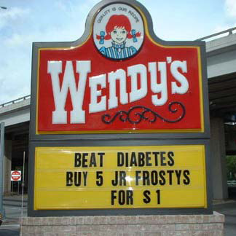
Policy, Environment & Systems Change
“It is unreasonable to expect that people will change their behavior easily when so many forces in
the social, cultural, and physical environment conspire against
such change.”
        – Institute of Medicine

